Slide 1

ETL with SQL Server Integration Services(SSIS)

Slide 2



Agenda
Day |  | Topics
Day 1 | 5/15/2019 | Introduction to SSIS , integration services and runtime engine - SSIS Architecture, Getting Started – Creating a package
 |  | Business Intelligence Development Studio
 |  | Control flow - Introduction of tasks and properties, Precedence Constraints
 |  | Containers
 |  | Connection and properties, bulk data load
Day 2 | 5/16/2019 | Data flow - Introduction of components, Connection Managers , Synchronous and asynchronous transformations, lookups
 |  | Data Sources, Data Destinations
 |  | Data Transformations
 |  | SCD2 implementation
 |  | Assignment
Day 3 | 5/17/2019 | Parameterization at package level and project level - Connection managers, Variables, Expression, Parameters
 |  | Data Viewer
 |  | Debugging - Breakpoints
 |  | SSIS Logging
 |  | SSIS Event Handlers
 |  | Checkpoints
 |  | Assignment
Day 4 | 5/20/2019 | ETL framework using master package to call child packages
 |  | Azure feature pack to integrate with Bigdata and Azure cloud
 |  | Deployment mechanism using file system and SQL server catalog
 |  | Scheduling mechanism and execution of package using command line
 |  | Best practices for optimal solutions

Slide 3
SSIS Architecture

Slide 4
SSIS Architecture
Integration Services has a architecture that separates data movement and transformation from Package control flow and management
Packages are the units of work that you execute
Tasks do the work in packages
Containers are objects that provide structure to packages

Slide 5

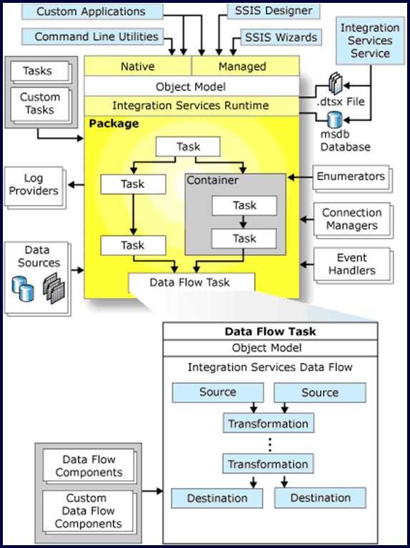
SSIS Architecture
The Integration Services service, available in SQL Server Management Studio, monitors running Integration Services packages and manages the storage of packages.
The run-time engine saves the layout of the packages, run the packages and provides support for logging
The data flow engine is a specialized, high performance engine that is exclusively dedicated to extracting, transforming, and loading data.

Slide 6

Getting Started

Slide 7

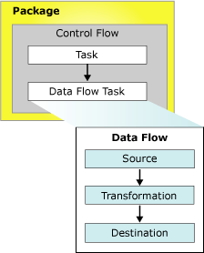
SSIS Packages
A package is an organized collection of connections, control flow elements, data flow elements, event handlers, variables, parameters, and configurations, that are assembled using either the graphical design tools that SQL Server Integration Services provides, or are build programmatically.
The following diagram shows a simple package that contains a control flow with a Data Flow task, which in turn contains a data flow.
Fig. 1

Slide 8

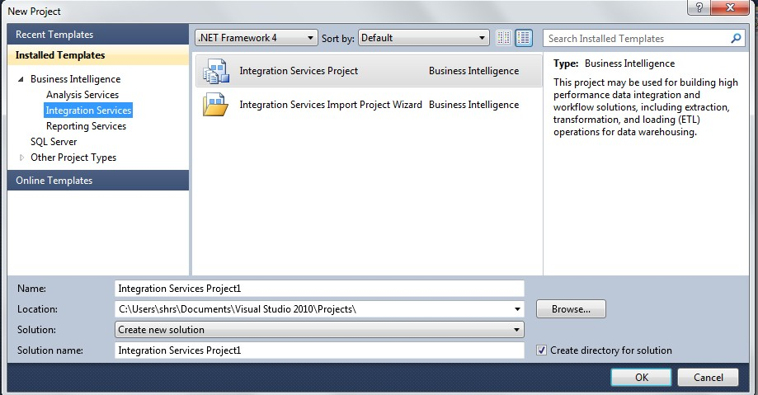
Creating an SSIS Package
Open Microsoft Visual Studio, click on File menu: New→ Project
Choose Business Intelligence → Integration Services →
Integration Services Project
Give name of Project and specify its location. Click on OK.

Slide 9

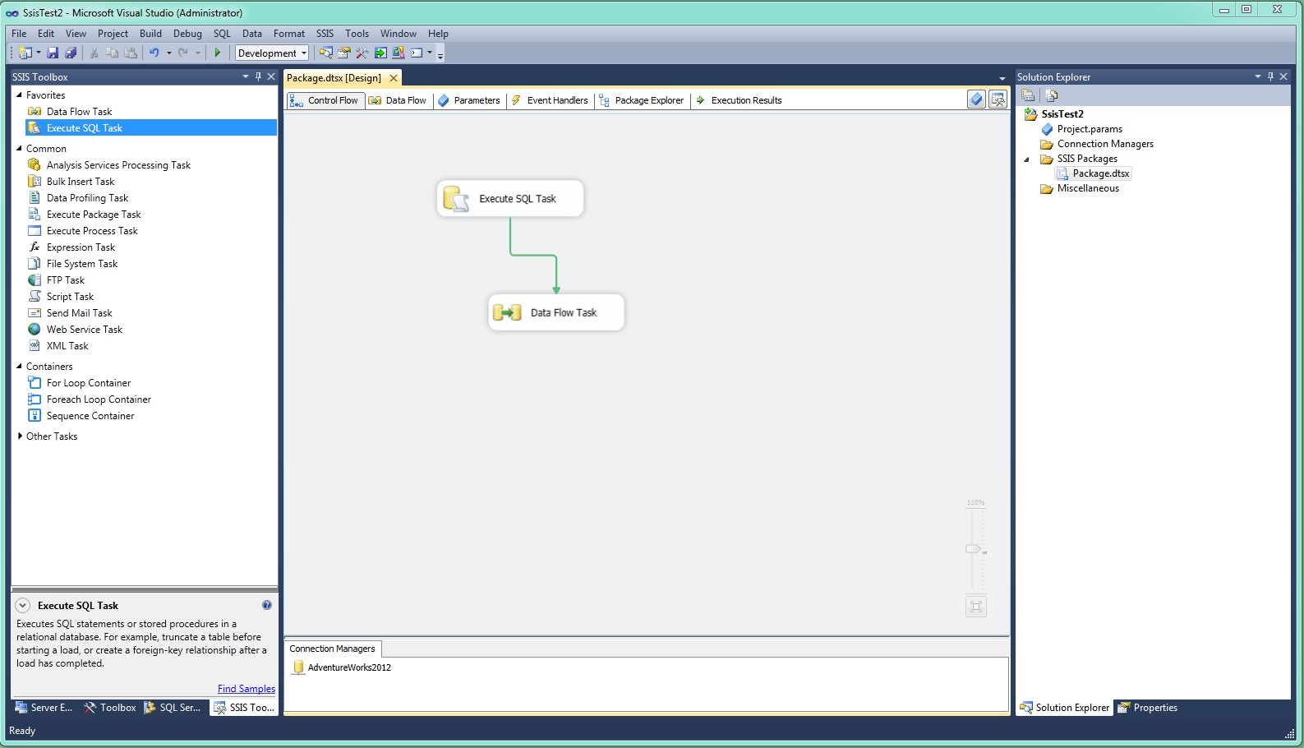



BIDS Layout
Menu Bar
Data Flow
Solution Explorer
Toolbox
Control Flow
Connection Managers

Slide 10

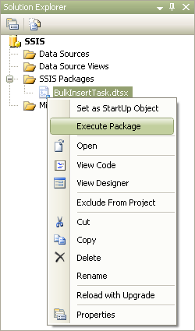
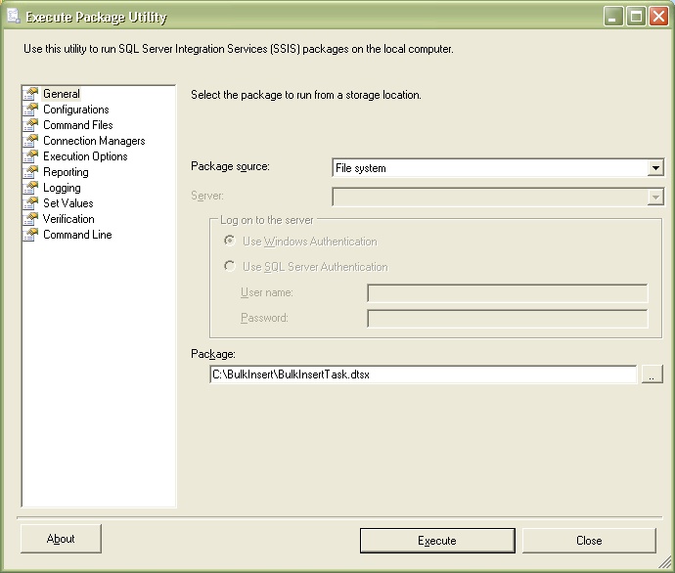
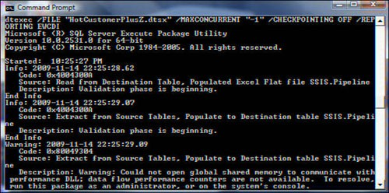
Executing SSIS Packages
SSIS packages can be executed using :
DTEXEC.exe Command Line Utility
DTEXECUI.exec Utility
SQL Agent
Business Intelligence Development Studio (BIDS)

Slide 11
Connection Managers

Slide 12
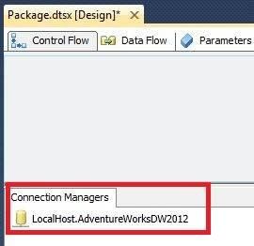
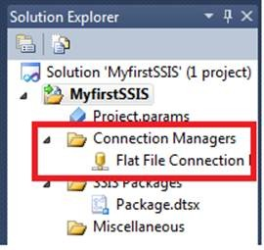
Designing Packages – Connection Managers
Sources and Destinations
SQL Server
Flat Files
Oracle
Web Services
SAPBI
TeraData
FTP
ODBC

Slide 13
Control Flow Tasks

Slide 14
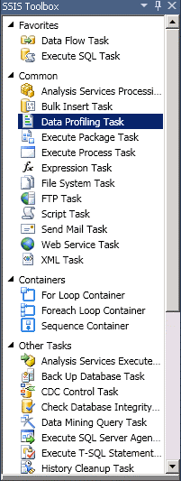
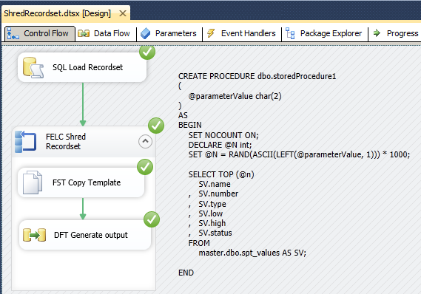
Designing Packages – Control Flow Tasks
Toolbox
Favorites
Common
Containers
Other Tasks
Control Flow
Central Location for Package Development
Containers help control programmatic workflow

Slide 15

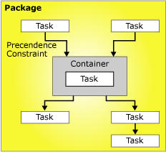
Control Flow
A control flow defines a workflow of tasks to be executed.
SSIS provides three different types of control flow elements:
containers that provide structures in packages,
tasks that provide functionality,
precedence constraints that connect the
executables, containers, and tasks into an ordered control flow.

Slide 16
Precedence Constraints

Slide 17

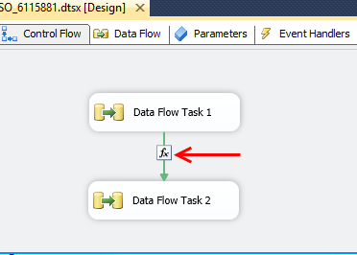
Precedence Constraints
A precedence constraint links two executables: the precedence executable and the constrained executable.
The precedence executable runs before the constrained executable and the execution result of the precedence executable may determine whether the constrained executable runs.
Precedence Constraints

Slide 18
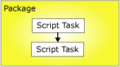
Precedence Constraints
The following diagram shows two executables linked by a precedence constraint :
Because the package is at the top of the SSIS container hierarchy, multiple packages cannot be linked by precedence constraints; however, you can add an Execute Package task to a package and indirectly link another package into the control flow.

Slide 19
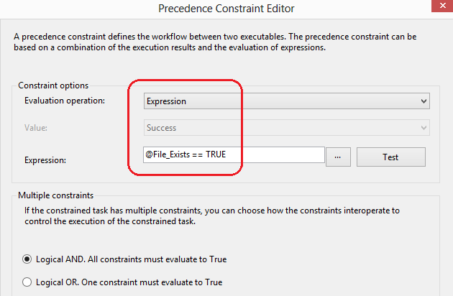
Precedence Constraints Evaluation Operations
A constraint that uses only the execution result of the precedence executable to determine whether the constrained executable runs. The execution result of the precedence executable can be completion, success, or failure.
An expression that is evaluated to determine whether the constrained executable runs. If the expression evaluates to true, the constrained executable runs.

Slide 20
Precedence Constraints
Evaluation Operations(contd.)
An expression and a constraint that combines the requirements of execution results of the precedence executable and the return results of evaluating the expression.
An expression or a constraint that uses either the execution results of the precedence executable or the return results of evaluating the expression.

Slide 21
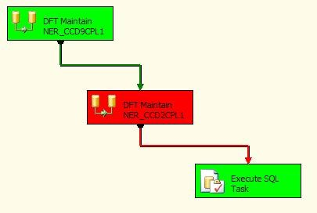
Precedence Constraints Execution Results
The precedence constraint can use the following execution results alone or in combination with an expression.
Completion requires only that the precedence executable has completed, without regard to outcome, in order for the constrained executable to run.
Success requires that the precedence executable must complete successfully for the constrained executable to run.
Failure requires that the precedence executable fail for the constrained executable to run.

Slide 22

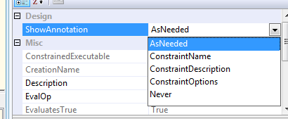
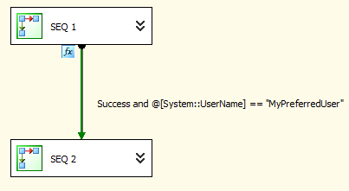
Annotated Precedence Constraints
Firstly, did you know that precedence constraints can be annotated with the expression that is placed upon that precedence constraint ? Each precedence constraint has a property called ‘ShowAnnotation’ and it has 5 possible values as depicted here:
Most of those options aren’t very useful but one of them, ‘Constraint Options’, can be very useful indeed if you have an expression on your constraint because it causes the expression to be displayed on your design surface like so:

Slide 23

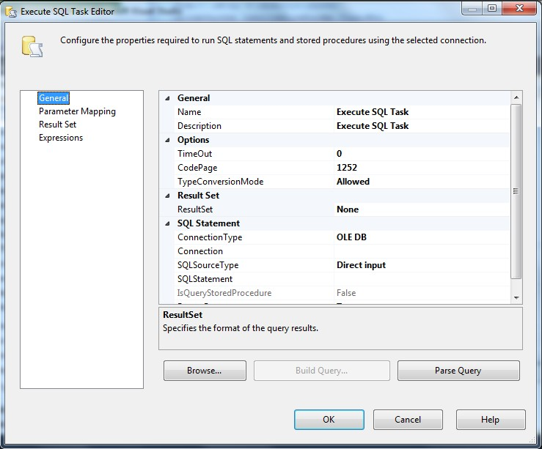
Execute SQL Task
The Execute SQL task runs SQL statements or stored procedures from a package.
The task can contain either a single SQL statement or multiple SQL statements that run sequentially.
Different connection managers used by this task :
Excel, ODBC, OLE DB, ADO .NET etc.
To use this in the package, drag it from SSIS Toolbox to the design surface.
Double click on it to open the editor.

Slide 24
Execute SQL Task
Several options present in the editor:
General:
Specify Name & Description of the task, Connection Type, Connection name, SQL statement and Result Set if the query returns a result set.
Parameter Mapping:
If the SQL Query requires values of parameters to be mapped during runtime, then specify them in this section in the same order as they are to be used in the query.
ResultSet:
Specify the result set name and the variable returning the result set.
Expressions:
If the task is supposed to run based on some conditions, then those conditions are specified here.

Slide 25

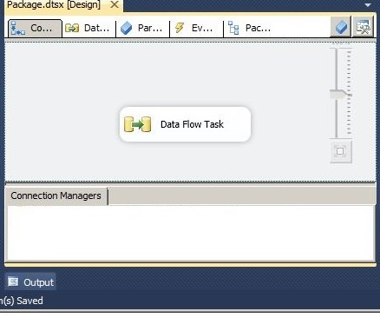
Data Flow Task
This is the heart and soul of SSIS “DATA FLOW TASK” aka DFT. As the name suggests, it is a task.
Data Flow Task that literally means a task where DATA flows. That’s exactly what ETL does, Extract Transform & Load of data. Most of the ETL is done in the Data Flow Task.
A Data Flow Task has to be a part of a ‘Control Flow’. One control flow can have a number of DFTs in it, as the Control Flow is the place where we can decide the workflow of the tasks to be executed.

Slide 26

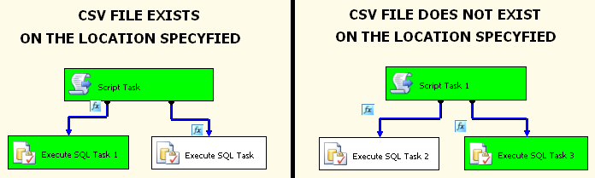
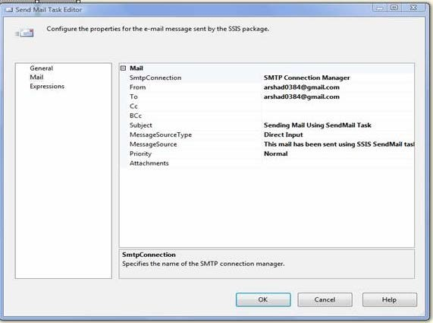
Send Email Task
The Send Mail task sends an e-mail message.
By using the Send Mail task, a package can send messages if tasks in the package workflow has succeeded or failed, or send messages in response to an event that the package raises at run time.
For example, the task can notify if a source file exists in a particular location or not.
•

Slide 27

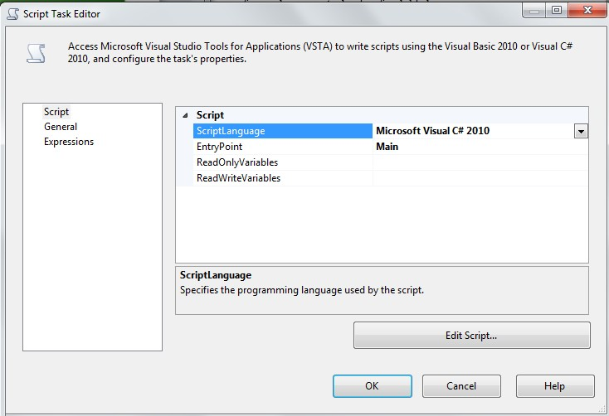
Script Task
Script tasks are a great way of extending SSIS functionality, when none of the built-in components are quite right for the task needed to be performed.
Such tasks may be:
Moving processing logic from external batch or script files into the package, or
Invoking a third-party API as part of the control flow, or
Accessing Active Directory information, or
Creating package-specific performance counters etc..

Slide 28
Script Task
Script Editor contains 3 sections:
Script:
◊ Script language: Visual C# or Visual Basic
◊ Entry point:
Specify method (specific to the selected script language) that SSIS runtime would call as the entry point into the code specified in the
ScriptMain class of the Visual Studio for Applications (VSTA) project.
In most cases, Main method works fine.
◊ Specify ReadOnlyVariables and ReadWriteVariables.
◊ Click on Edit Script to open VSTA project window.
General: Specify name & description
Expressions: Use this to set conditions for this editor

Slide 29

Containers
Containers are objects that provide structure to packages and services to tasks.
They support repeating control flows in packages and they group tasks and containers into meaningful units of work.
Containers can include tasks and other containers also.
Integration Services provides the following types of containers for building packages:
Foreach Loop Container
Sequence Container
For Loop Container
For Loop Container-
Runs a control flow repeatedly by testing a condition.
Similar to For Loop in C/C++/Java program, here we can give initial, evaluation and assignment expressions.

Slide 30

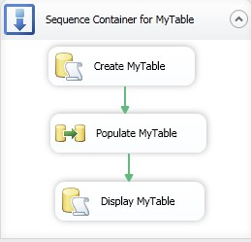
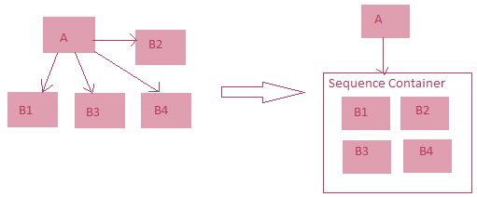
Sequence Container
Groups tasks and containers into more understandable subsystems.
Advantages:
When a sequence of tasks is to be executed based on some conditions, then those tasks can be put under this container and conditions may be imposed on the container itself.
Since it can be collapsed, so it makes the package more readable.
Ensures parallel execution of tasks in more presentable manner.

Slide 31
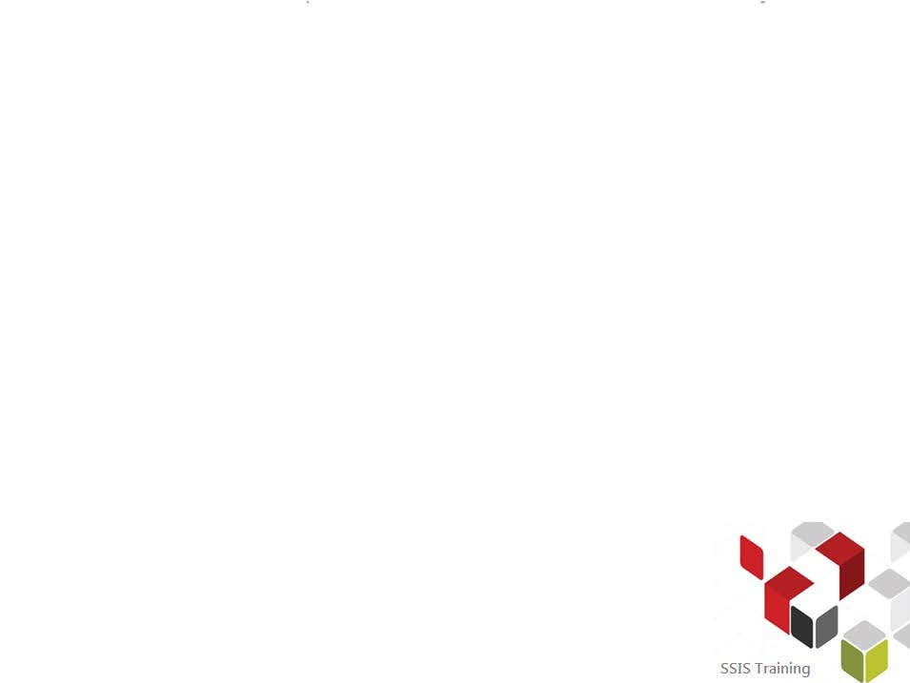
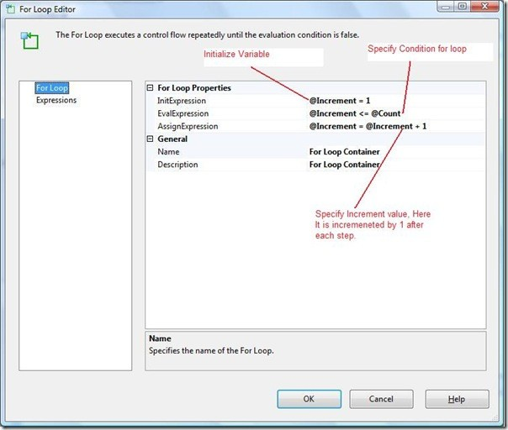
For Loop Container
For Loop container evaluates an expression and repeats its workflow until the expression evaluates to False.
An optional initialization expression
that assigns values to the loop counters.
An evaluation expression that contains the expression used to test whether the loop should stop or continue.
An optional iteration expression that increments or decrements the loop counter.

Slide 32

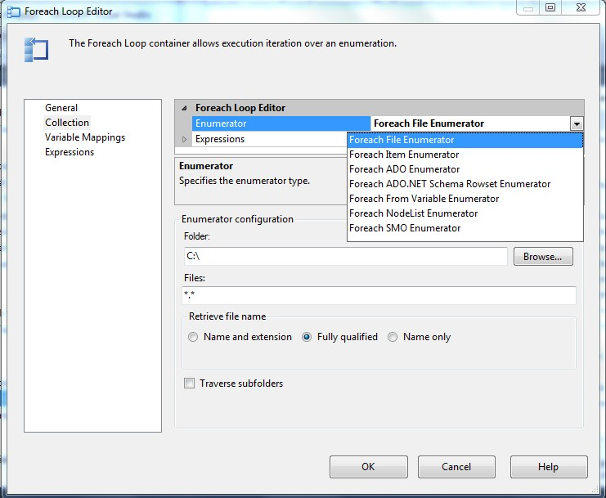
Foreach Loop Container
Runs a control flow repeatedly by using an enumerator.
SSIS provides the following enumerator types:
Foreach File enumerator to enumerate files in a folder.
Foreach Item enumerator to enumerate items in a collection, say, executables specified in Execute Process Task.
Foreach ADO enumerator to enumerate rows in tables.
Foreach NodeList enumerator to enumerate the result set of an XML Path Language (XPath) expression.
Foreach SMO enumerator to enumerate SQL Server Management Objects (SMO) objects, say, list of views.

Slide 33
Foreach Loop Container
Foreach Loop Editor consists of the following options:
General:
Specify name & description
Collection:
Specify enumerator type and associated options.
Example: For ‘Foreach File enumerator’ , specify folder name and pattern for the file names to be retrieved. Check on ‘Traverse sub-folders’ if required.
Variable Mappings:
The value or name returned by the enumerator in one iteration can be stored in a variable specified here.
Expressions:
Use this to set conditions for this editor.

Slide 34

Data Flow Tasks

Slide 35

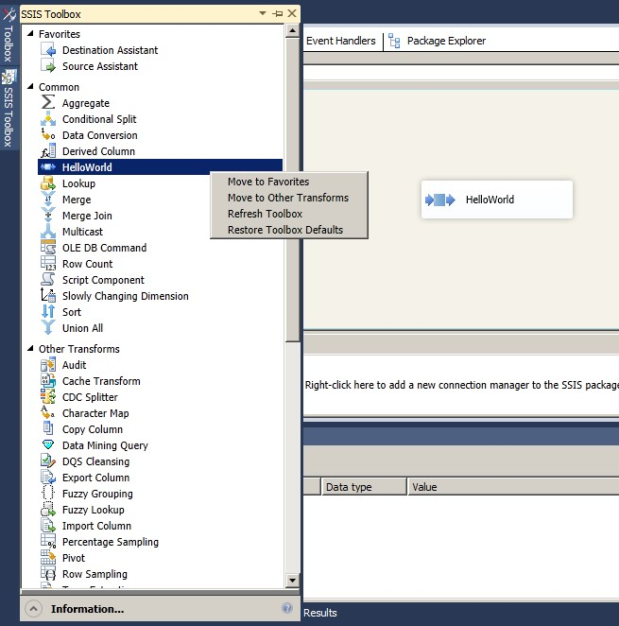
Designing Packages – Data Flow Tasks
Toolbox
Data Flow Sources
Transformations
Data Flow Destinations
Data Flow Tab
Data Flow Development
Multiple Data Flows Can Exist in a Package
Connection Mangers are required to define Data Source and Data Destination
Connectors

Slide 36

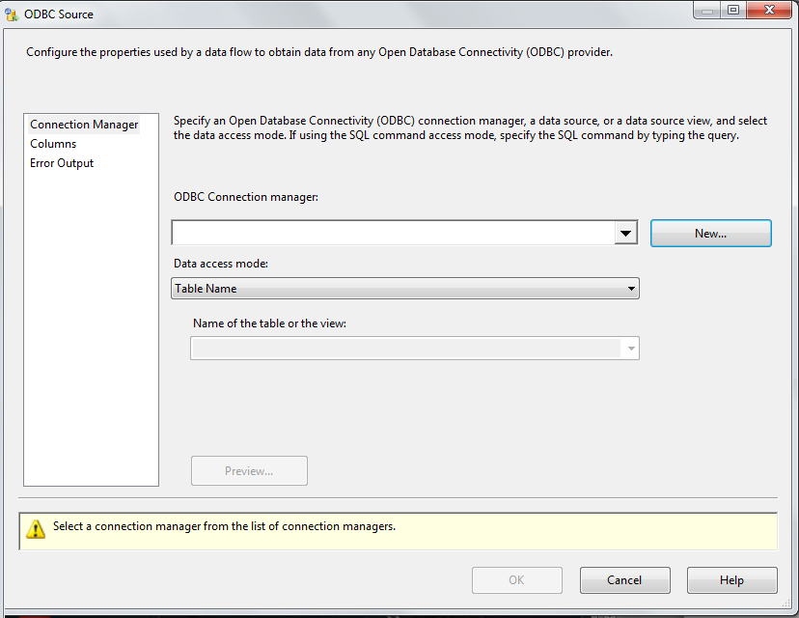
Data Sources
In Integration Services, a source is the data flow component that makes data from different external data sources available to the other components in the data flow.
SSIS supports OLE DB, FLAT FILE, ADO .NET SQL Client, RAW FILE, ODBC, XML, EXCEL etc.
ODBC -
ODBC extracts data from Open Database Connectivity compliant database.
Extract from a database table or view , or use a SQL command
In ODBC Editor, specify ODBC Connection Manager, data access mode i.e. from table or SQL command.

Slide 37
Data Sources
If the ODBC connection doesn’t exist, it can be created by the following steps:
Clicking on New in ODBC Editor and New in ODBC connection Manager Window
Selecting data source, building connection string by specifying path of the database file
Specifying Login information for the database if any exists.
OLE DB :
The OLE(Object Linking and Embedding) DB source extracts data from a variety of OLE DB-compliant relational databases by using a database table, a view, or an SQL command. For example, it can extract data from tables in Microsoft Office Access or SQL Server databases.
It provides four different data access modes for extracting data:
A table or view
A table or view specified in a variable
Results of a SQL statement. The query can be a parameterized query.
The results of an SQL statement stored in a variable.

Slide 38
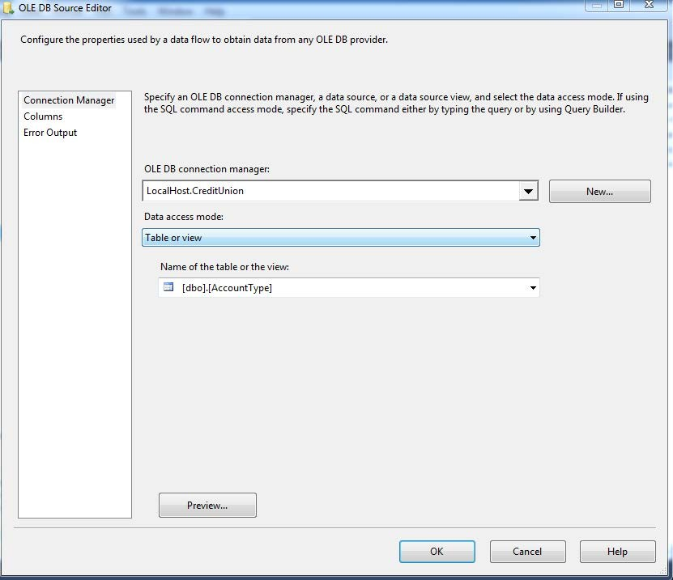
Data Sources
OLE DB Source Editor:
Select Provider
Specify Connection Manager, data access mode and other details associated with it.
Select columns to be used for output.
To handle errors that might occur by redirecting error rows, ignoring error rows etc., set the same in Error Output section.

Slide 39
Data Sources
RAW FILE:
The Raw File source reads raw data from a file.
Because the representation of the data is native to the source, the data requires no translation and almost no parsing. This means that the Raw File source can read data more quickly than other sources such as the Flat File and the OLE DB sources.
This source does not use a connection manager.
This source has one output. It does not support an error output.
The Raw File source is used to retrieve raw data that was previously written by the Raw File destination.
In Raw File source editor, select data access mode and the raw file and select required columns to be used.

Slide 40
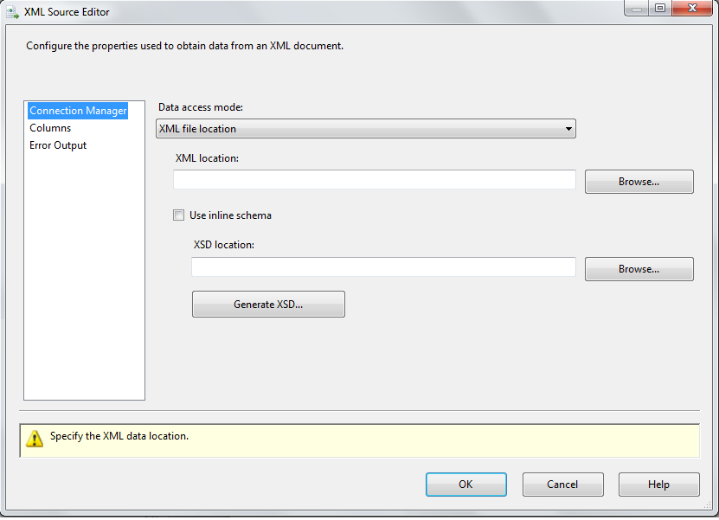
Data Sources
XML source:
Extracts data from an XML file.
XML Source Editor:
Select file.
If after selection, an error message is shown stating XML Schema (XSD) not specified, then,
Click on Generate XSD to generate one and store it in the same location as that of the xml file.
XML Schema stores the definition of the XML file

Slide 41

Data Destinations
A destination is the data flow component that writes the data from a data flow to a specific data store, or creates an in-memory dataset.
Data can be loaded to various destinations such as: Flat File, OLE DB , ODBC, ADO .NET, Raw File etc.
OLE DB Destination:
The OLE DB destination loads data into a variety of OLE DB-compliant databases such as Microsoft Office Access , SQL Server databases etc. using a database table or view or an SQL command.
It provides five different data access modes for loading data:
A table or view - Specify an existing table or view, or create a new table.
A table or view using fast-load options
A table or view specified in a variable.
A table or view specified in a variable using fast-load options.
The results of an SQL statement.

Slide 42
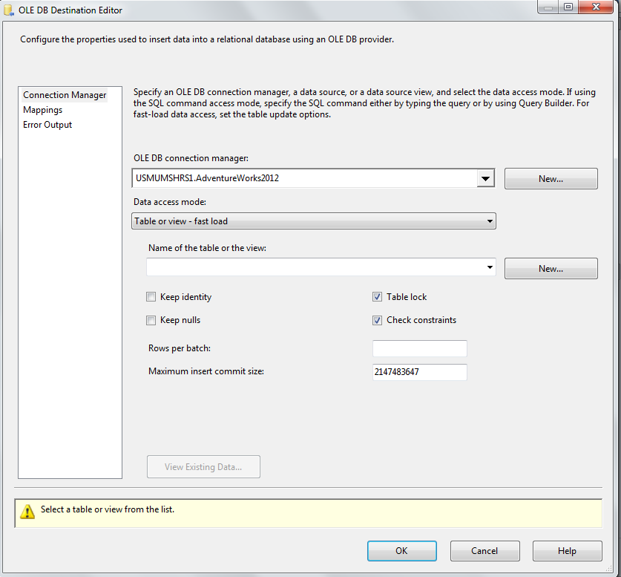
Data Destinations
Table or Views data access mode commits each row at a time as a transaction. Thus, a package transferring 5 million rows take quite a long time (30+ mins).
With Fast-load data access, data is committed in batches. So, inserting 5 million records would take just over 2 mins.
Options associated with fast-load data access mode :
Keep identity: Check this to keep values from the imported data file or leave it
unchecked to use unique values assigned by SQL Server.
Keep Nulls: Check this to retain null value during the bulk load operation.
Check constraints on the target table or view during the bulk import operation.
Acquire a table-level lock for the duration of the bulk load operation.
Specify the number of rows per batch and maximum insert commit size

Slide 43
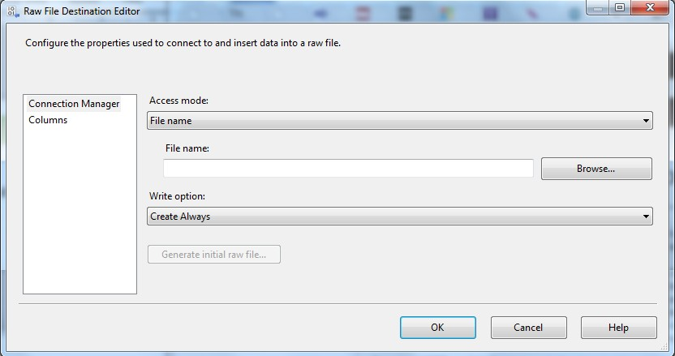
Data Destinations
RAW FILE Destination:
The Raw File destination writes raw data to a file.
Since, format of the data is native to the destination, the data requires no translation and little parsing. Thus this destination writes data more quickly than other destinations such as the Flat File and OLE DB destinations.
Flat File Destination Editor:
Specify Access mode: File Name or File Name from variable
Browse for File or choose the variable
Select Write Option as either of the following:
Create Always
Create Once
Append
Truncate and Append

Slide 44

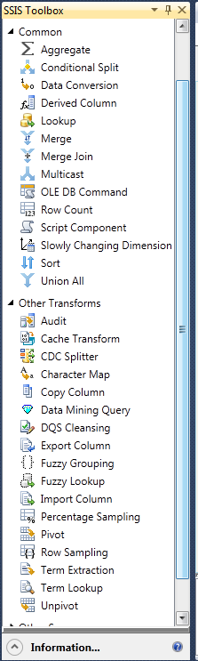
Data Transformations
SQL Server Integration Services transformations are the components in the data flow of a package that aggregate, merge, distribute, and modify data, perform lookup operations and generate sample datasets etc.
Some Transformations supported by SSIS: Slowly Changing Dimension, Term Extraction, Character Map, Data Conversion,
Derived Column,
Script Component, OLE DB Command, Aggregate, Conditional Split, Multicast ,Union All ,Merge, Merge Join, Lookup ,Cache Transform,
Row Count etc.

Slide 45
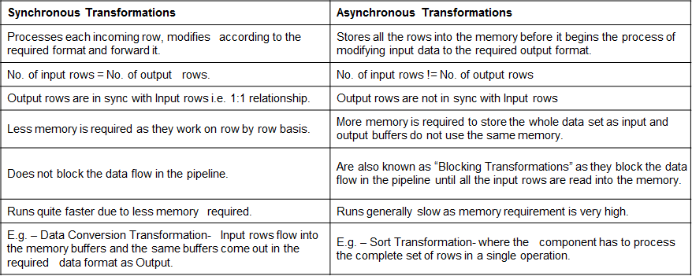
Transformation Categories
All the Data Flow Transformations are broadly classified into 2 types:- Synchronous Transformations.
Asynchronous Transformations.

Slide 46
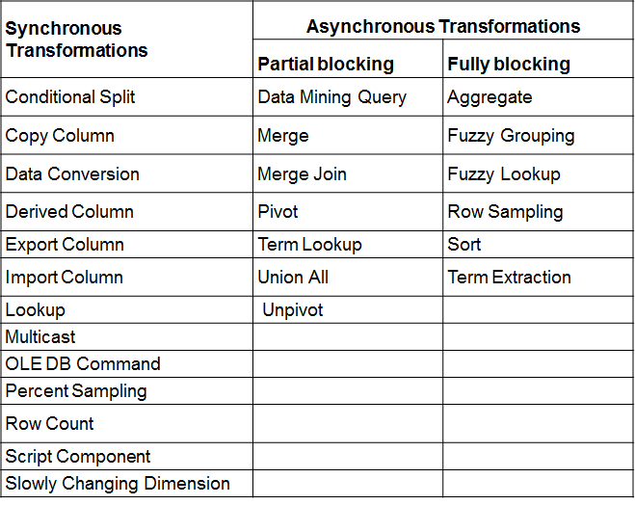
Transformation Categories

Slide 47

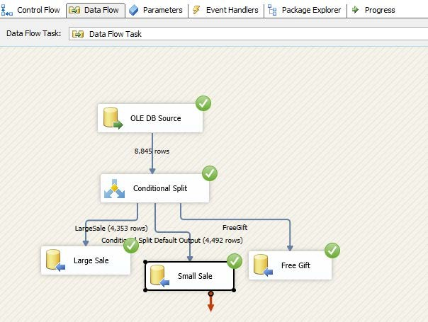
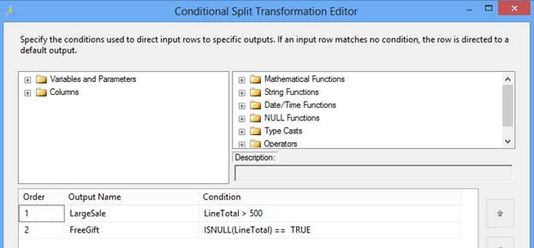
Data Transformation – Conditional Split
Allows you to send the data from a single data path to various outputs or paths based on conditions that use the SSIS expressions.
Data flow task design for Conditional Split:

Slide 48

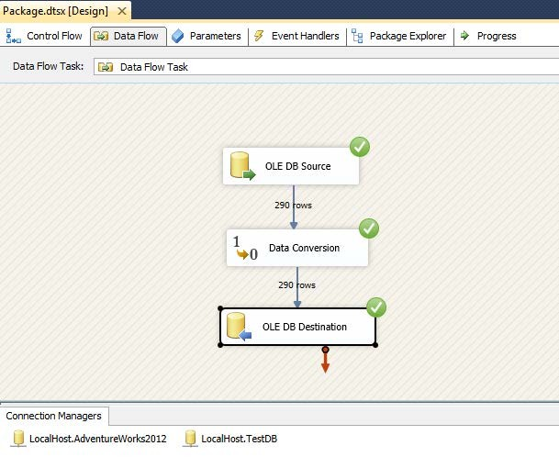
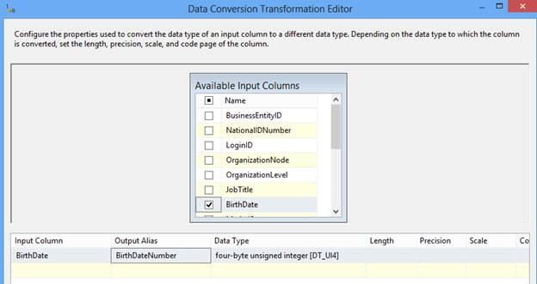
Data Transformation – Data Conversion
It is a similar function to the Convert or Cast functions in T- SQL.
It is a very useful transformation if we are pulling same data from multiple sources

Slide 49

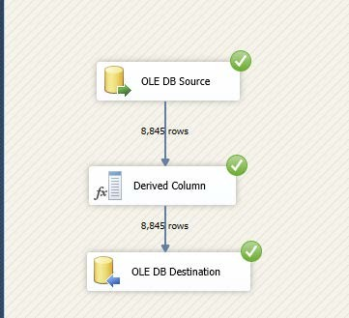
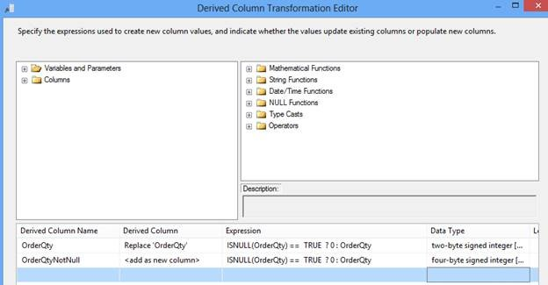
Data Transformation – Derived Column
Creates a new column that is derived from the output of another column.
This transformation provides you two options; either you can create a new column as a derived column or replace the existing column with a new derived column.

Slide 50

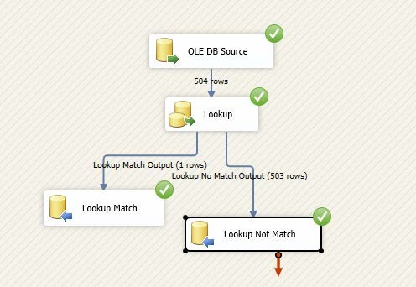
Data Transformation – Lookup
Allows you to perform an equi-join between values in the transformation input and values in the reference dataset similar to T-SQL. This transformation is used to join two datasets at a time.
To join more than two datasets we need to put multiple Lookup transformations, similar to a T-SQL join condition.

Slide 51
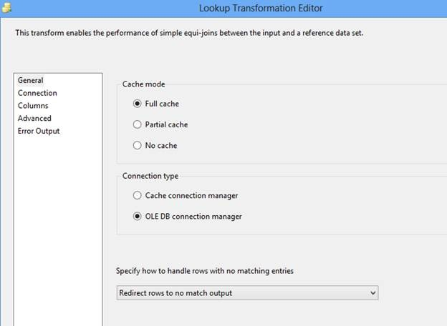
Data Transformation – Lookup
If there is no matching entry in the reference dataset, no join occurs. By default, the Lookup transformation treats rows without matching entries as errors.

Slide 52
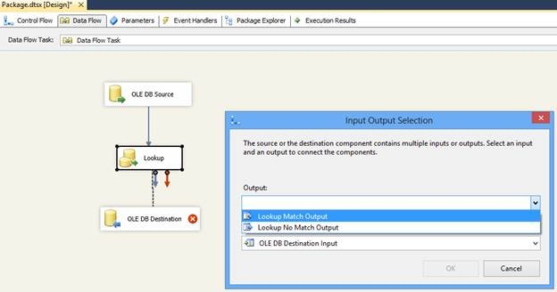
Data Transformation – Lookup
It can be configured to redirect non matching rows to a no match output.

Slide 53
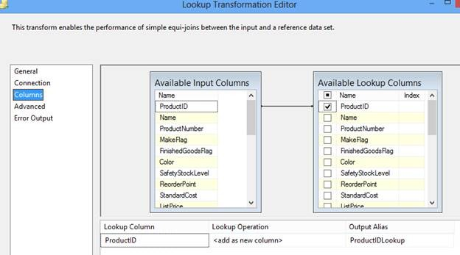
Data Transformation – Lookup
The join can be a composite join, which means that multiple columns can be used in the join in the transformation input to columns in the reference dataset;

Slide 54

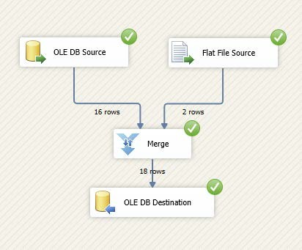
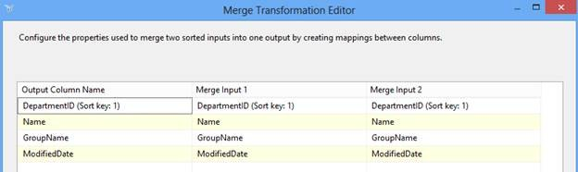
Data Transformation – Merge
Merges two sorted data sets into a single dataset.
This transformation is very useful when during ETL its needs to merge data from two different data sources.
Merge transformation can’t merge a column that has a numeric data type with a column that has a character data type.

Slide 55

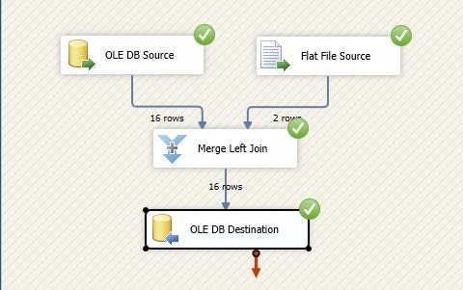
Data Transformation – Merge Join
Allows joining data from two sorted datasets using a FULL, LEFT, or INNER join.
It also has two inputs and one output and does not support an error output.

Slide 56

Data Transformation – Merge Join
Merged data from two different sources; OLEDB and Flat File, applying a Left outer join on DepartmentID.

Slide 57


Data Transformation – Multicast
Allows you to distribute its input to one or more outputs.
This transformation is similar to the Conditional Split transformation. Both transformations direct an input to multiple outputs. The difference between the two is that the Multicast transformation directs every row to every output, and the Conditional Split directs a row to a single output.

Slide 58

Data Transformation – Multicast
Distributing log data to two different destinations.

Slide 59



Data Transformation – Sort
Allows sort or arrange input data in ascending or descending order and copies the sorted data to the transformation output.
Multiple sorts to an input can be applied; the column with the lowest number is sorted first, the sort column with the second lowest number is sorted next.

Slide 60



Data Transformation – Union All
Allows you to combine multiple (more than two) input and produce one output.
Its add inputs to transformation output one after the other and doesn’t sort the data.

Slide 61
Data Transformation – Slowly Changing Dimension
Slowly Changing Dimensions (SCD) are dimensions that have data that slowly changes.
The Type 1 methodology overwrites old data with new data, and therefore does not track historical data at all.
The Type 2 method tracks historical data by creating multiple records in the dimensional tables with separate keys.
The Type 3 method tracks changes using separate columns.
Fixed Attribute: When the value in a column should not change.
Changing Attribute: When changed values should overwrite existing values. This is the SCD1.
Historical Attribute: When changes in column values are saved in new records. Previous values are save in records marked as outdated. This is the SCD2.
For SCD2 in SSIS, either of the flags can be used.
Use one column. It can be valued TRUE /FALSE or Current / Expired Use two columns with DATE data type (StartedDate and EndedDate)

Slide 62







Data Transformation – Slowly Changing Dimension
1.Before SCD
2. SCD Transformation
3. Choosing Business
4. Selecting type
5. After package execution
6. After SCD

Slide 63





Data Transformation – Slowly Changing Dimension
1.Before SCD
3.Selecting Flag value
2.Choosing SCD type
4.SCD Transformation
5. After SCD

Slide 64

Variables in SSIS

Slide 65

Variables
Variables store values that a SQL Server Integration Services package and its containers, tasks, and event handlers can use at run time.
You can use variables in Integration Services packages for the following purposes:
Updating properties of package elements at run time. For example, you can dynamically set the number of concurrent executables that a ‘Foreach’ Loop container allows.
Including an in-memory lookup table. For example, a package can run an Execute SQL task that loads a variable with data values.

Slide 66

Use of Variables
Loading variables with data values and then using them to specify a search condition in a WHERE clause. For example, the script in a Script task can update the value of a variable that is used by a Transact-SQL statement in an Execute SQL task.
Loading a variable with an integer and then using the value to control looping within a package control flow. For example, you can use a variable in the evaluation expression of a For Loop container to control iteration.
Populating parameter values for Transact-SQL statements at run time. For example, a package can run an Execute SQL task and then use variables to dynamically set the parameters in a Transact-SQL statement.
Building expressions that include variable values. For example, the Derived Column transformation can populate a column with the result obtained by multiplying a variable value by a column value.

Slide 67


System Variables
When you create a new package, add a container or a task to a package, or create an event handler, Integration Services includes a set of system variables for the container. System variables contain useful information about a package, container, task, or event handler.

Slide 68

System Variables

Slide 69


User-Defined Variables
User-defined variables can be used in many ways in SSIS: in scripts; in the expressions used by precedence constraints, the For Loop container, the Derived Column transformation, and the Conditional Split transformation; and in the property expressions that update property values.

Slide 70

Variables Usage Scenarios
Data Flow Expressions :
Use variables to provide values in the expressions that the Derived Column and Conditional Split transformations use to populate columns, or to direct data rows to different transformation outputs.
Precedence Constraint Expressions :
Provide values to use in precedence constraints to determine whether a constrained executable runs. The expressions can be used either together with an execution outcome (success, failure, completion), or instead of an execution outcome.

Slide 71
Variables Usage Scenarios
Parameters and Return Codes :
Provide values to input parameters, or store the values of output parameters and return codes. You do this by mapping the variables to parameters and return values.
For Loop Expressions :
Provide values to use in the initialization, evaluation, and assignment expressions of the For Loop.

Slide 72
Variables Usage Scenarios
Parent Package Variable Configurations :
Pass values from parent packages to child packages. Child packages can access variables in the parent package by using parent package variable configurations. For example, if the child package must use the same date as the parent package, the child package can define a parent package variable configuration that specifies a variable set by the GETDATE function in the parent package.
Script Task and Script Component :
Provide a list of read-only and read/write variable to the Script task or Script component, update the read/write variables within the script, and then use the updated values in or outside the script.

Slide 73


Properties of Variables
The following table lists properties of variables that may be updatable :
The values of the Name and Namespace properties must begin with an alphabetic character letter as defined by the Unicode Standard
2.0, or an underscore (_). Subsequent characters can be letters or numbers as defined in the Unicode Standard 2.0, or the underscore (_).

Slide 74
Expressions in SSIS

Slide 75


Expressions
An expression is a combination of symbols—identifiers, literals, functions, and operators—that yields a single data value.
Simple expressions can be a single constant, variable, or function.
More frequently, expressions are complex, using multiple operators and functions and referencing multiple columns and variables.

Slide 76

Components that use Expressions
The Conditional Split transformation implements a decision structure based on expressions to direct data rows to different destinations. Expressions used in a Conditional Split transformation must evaluate to true or false. For example, rows that meet the condition in the expression "Column1 > Column2" can be routed to a separate output.
The Derived Column transformation uses values created by using expressions either to populate new columns in a data flow, or to update existing columns. For example, the expression Column1 + " ABC" can be used to update a value or to create a new value with the concatenated string.
Variables use an expression to set their value. For example, GETDATE() sets the value of the variable to the current date.

Slide 77
Components that use Expressions
Precedence constraints can use expressions to specify the conditions that determine whether the constrained task or container in a package runs.
Expressions used in a precedence constraint must evaluate
to true or false. For example, the expression @A > @B compares two user-defined variables to determine whether the constrained task runs.
The For Loop container can use expressions to build the initialization, evaluation, and the incrementing statements that the looping structure uses. For example, the expression @Counter = 1 initializes the loop counter

Slide 78
Package Debugging

Slide 79

Package Debugging
Control flow
Breakpoints
Progress Reporting
Debug Window
Data flow
Data Viewer
Row Count
Progress Reporting

Slide 80


Data Viewers – Debugging Data Flow
A data viewer is a browser that you can attach to paths between two Data Flow components.
Set data viewers before or after the component in question to see whether the component is working as intended.

Slide 81

Data Viewers
Data viewers work like a composite tool of the breakpoints and debug windows. The SSIS engine suspends data flow execution while you are browsing through a data viewer. SSIS Designer allows you to detach and attach data viewers during the execution, just like the breakpoints in Control Flow. If you are finished browsing through the data, you can simply detach the data viewer to let the rest of the data go through.

Slide 82


Progress Reporting
The following table describes the colors that are used to depict execution status

Slide 83

Progress Reporting
The Progress tab lists tasks and containers in execution order and includes the start and finish times, warnings, and error messages. The messages under each component appear in chronological order.
Event messages derived by each component appear under the component name. The messages of each component usually start with a validation message such as Validation Has Started, Progress: Validating, and Validation Is Complete.

Slide 84


Row Count and Progress Reporting
Row Counts after each component specifies the number of records were processed through that component.
Color coding specifies the state of the task :
Green : Complete
Yellow : Running
White : Yet to process
Red : Failed.

Slide 85

Breakpoints
Debugging Control Flow
Features and tools that you can use to troubleshoot the control flow in an Integration Services package.
Integration Services supports breakpoints on containers and tasks.
SSIS Designer provides progress reporting at run time.
Business Intelligence Development Studio provides debug windows.

Slide 86

Breakpoints - Debugging Control Flow
SSIS Designer provides the Set Breakpoints dialog box, in which you can set breakpoints by enabling break conditions and specifying the number of times a breakpoint can occur before the execution of the package is suspended.
Breakpoints can be enabled at the package level, or at the level of the individual component.
If break conditions are enabled at the task or container level, the breakpoint icon appears next to the task or container on the design surface of the Control Flow tab.
If the break conditions are enabled on the package, the breakpoint icon appears on the label of the Control Flow tab.
When a breakpoint is hit, the breakpoint icon changes to help you identify the source of the breakpoint.

Slide 87


Enabling Breakpoints
When a breakpoint is hit, the breakpoint icon changes to helps to identify the source of the breakpoint.
Breakpoints can be added, deleted, and changed when the package is running.

Slide 88

Enabling Breakpoints
To add flexibility and power to a breakpoint, you can modify the behavior of a breakpoint by specifying the following options:
The hit count or the maximum number of times that a break condition occurs before the execution is suspended.
The hit count type or the rule that specifies when the break condition triggers the breakpoint.

Slide 89



Breakpoint for ForEach Loop Container
Notice that a red dot is displayed on For Each Loop Container. This indicates that a breakpoint has been set on this Container.
When executing a package that contains components with breakpoints configured, package will show that the particular component has stopped at the configured breakpoint by adding a yellow arrow to the inside of the red dot that is place on that component (to indicate that the package is in break mode and has halted at this task).

Slide 90


Progress Reporting - Debugging Control Flow
SSIS Designer includes two types of progress reporting: color-coding on the design surface of the Control Flow tab, and progress messages on
the Progress tab.
When a package is executed, SSIS Designer depicts execution progress by displaying each task or container using a color that indicates execution status. Color determines whether the element is waiting to run, currently running, has completed successfully, or has ended unsuccessfully.
After package execution is stopped, the color-coding disappears.

Slide 91

Debug Window – Debugging Control Flow
The Breakpoints window provides a list of the breakpoints currently set in the package. You can activate, deactivate, and delete breakpoints by using this window. You can also modify the break condition of each breakpoint through this window.

Slide 92

Debugging Data Flow
When your package encounters the following issues, you need to investigate the Data Flow task:
A Data Flow task produces no result data, or it produces the wrong number of records. You would like to discover the component that is causing the issue.
In a Data Flow task, unexpected data is produced during the transformation. You would like to suspend the data flow and look into the passed data.
You might have noticed that SSIS Designer doesn't allow you to set breakpoints to Data Flow components. This is because the breakpoints and debug windows might not be efficient tools when you inspect data flowing inside the Data Flow task. Instead of the
breakpoints and debug windows, SSIS Designer provides you with a tool called data viewers.

Slide 93

SSIS Logging

Slide 94

SSIS Logging
SSIS logging helps to keep track of the packages running on the servers.
The logging options in SSIS allows to record run time package information such as execution time and errors.
Logging can be done to a number of key areas like SQL Server tables, the Windows Event Log, text files or XML files.

Slide 95

Native Logging
Windows Event Log - The Windows Event Log option logs the data to the Windows Event Log. This is perfect if you want to integrate with 3rd party monitoring solutions.
Text File - The Text File option saves the information into a plain text file with the data comma separated.
XML File - The XML File option saves the data in an XML File parsed into XML nodes.

Slide 96
Native Logging
SQL Server - The SQL Server option logs the data to a SQL table. The table logged to on the server is named SYSssisLog.” If it does not exist, this table is created automatically by SSIS when the package runs.
SQL Server Profiler - The SQL Server Profiler option logs the data to a file as SQL that can be captured in SQL Server Profile

Slide 97



Enable Logging
Select the provider type for the package. More than one type of logging can be done.
Place a check next to the package name in the left pane.
The drop down menu show compatible providers. If there is no connection to a provider then can click <New Connection…> to create the proper connection

Slide 98

Enable Logging
Then select the details of what information needs to be logged.
Under the Details tab, select the events for logging. If the event occurs during the package run time it will log the data to the selected provider. No matter which provider is selected a connection needs to be selected to use in logging.

Slide 99
Enable Logging
Under the Details tab an event is selected to be logged. If the event occurs during the package runtime it logs the data to the selected provider.
OnError, onWarning, onPreExecute, and onPostExecute are some commonly used events.
OnError fires if an error occurs during the execution of the package.
OnWarning fires if a warning occurs during the package execution. The onPreExecute event logs all the data before the package begins execution.
The onPostExecute event option logs all of the data after the package has completed execution.

Slide 100

Event Handlers

Slide 101

Event Handlers
Event handlers call tasks when events like errors or warnings occur on a package during execution, this can be used in logging errors or sending notifications to users.
The event handler’s tasks only run if that event is called. Here are the events that can occur in a package to cause an event to fire and call an event handler:
OnError
OnExecStatusChanged
OnInformation
OnPostExecute
OnPostValidate
OnPreExecute
OnPreValidate
OnProgress
OnQueryCancel
OnTaskFailed

Slide 102

Frequently used Event Handlers
Some of the most frequently used events are OnError, OnWarning, OnPreExecute, and OnPostExecute.
The OnError event fires when an error occurs on the package.
The OnWarning event fires when a warning occurs on a package.
The OnPreExecute event fires just before the executable or the package start.
The OnPostExecute event fires just after the selected executable or the package finishes executing.

Slide 103


Enabling Event Handlers
In the Event Handlers there is a blue link in the middle used to create an Event Handler. When clicked, this link creates an event handler on the package.
Two dropdown menus exist at the top of the Event Handlers Tab.
The drop-down menu on the left contains a list of all executables in the package. This list contains all the tasks in the package.
The dropdown menu on the top right, contains a list of all the events that can be chosen for the selected executable.

Slide 104

Checkpoints

Slide 105

Checkpoints
Checkpoint file is a XML file that record tasks that are completed successfully and the values of package variables so that the package's "state" can be restored to what it was when the package failed.
Values of variables that have the Object data type are not saved in checkpoint files.
Package configurations are also stored in checkpoint file.

Slide 106
Checkpoints
Using checkpoints in a package can provide the following benefits :
Avoid repeating the downloading and uploading of large files.
Avoid repeating the loading of large amounts of data.
Avoid repeating the aggregation of values.

Slide 107
Checkpoints
Defining Restart Points
The task host container, which encapsulates a single task, is the smallest atomic unit of work that can be restarted.
The ‘Foreach’ Loop container and a transacted container are also treated as atomic units of work.
When the package is restarted, the transacted container and its child containers run again.
A package can be restarted only at the control flow level.

Slide 108
Checkpoints
Configuring a Package to Restart
The Configuration file also includes the unique identifier of the package.
To successfully restart a package, the package identifier in the checkpoint file and the package must match; otherwise the restart fails.
This prevents a package from using a checkpoint file written by a different package version.

Slide 109

Checkpoints
The following table lists the package properties that you set to implement checkpoints :
Additionally, you must set the ‘FailPackageOnFailure’ property to true for all the containers in the package that you want to identify as restart points.

Slide 110


Checkpoint Usage
The ‘CheckpointUsage’ property can be set to the following values:

Slide 111
Checkpoints
Points to Note
Using checkpoints and transactions in the same package could cause unexpected results. For example, when a package fails and restarts from a checkpoint, the package might repeat a transaction that has already been successfully committed.
The typical behavior in a database transaction where we have multiple T- SQL commands is that either they all succeed or none of them succeed (i.e. on failure any previous commands are rolled back). The Checkpoint behavior, essentially, is that each command (i.e. task in the SSIS package) is committed upon completion. If a failure occurs the previous commands are not rolled back since they have already been committed upon completion.

Slide 112



Checkpoints
Points to Note(contd.)
If you want to use Checkpoints in SSIS you should run the tasks sequentially instead of parallel because your package will not run like you would anticipate.
Checkpoints prevent right side from continuing even though its correct. It depends on how fast the tasks on the right
can run before they get caught in the trap.

Slide 113
Package Explorer

Slide 114

Package Explorer
Provides a Hierarchical view of package design
Allows the viewing of Properties from the property window
Components can be deleted from the Package Explorer view, but cannot add components.
The Properties window is available for all objects, in all tabs including the
package itself.

Slide 115
SSIS Configurations

Slide 116

SSIS Configurations
One of the main challenges an SSIS developer is configuration of the packages. You will want to externalize the key elements in the package like connections and variables so you can seamlessly migrate the packages from development to production without having to open up each individual package. This is where SSIS package configurations help. Package configurations enable a developer or an administrator to have one key area where specified settings are stored. The administrator can then change the connection information one time and any referring packages will change as well.
Before starting a discussion on configurations, it’s important to know the execution order of a package. When a package starts, it goes through many phases:

Slide 117
SSIS Configurations applied during run time
When you use the dtexec command promot utility (dtexec.exe) to run a deployed package, the utility applies package configuration twice.
The dtexec utility loads the package.
The utility applies the configurations that were specified in the package at design time and in the same order as they were specified. There is an exception to Parent Package Variables Configurations which gets applied only once and at a later time.
The utility then applies any options that are specified on the command line using /SET command.
The utility reloads the configurations that were specified in the package at design time and in
the same order as they were specified. The utility uses any command line options that were specified to reload the configurations Therefore, different values might be reloaded from a different location.
The utility applies the Parent Package Variable Configurations.
The utility runs the package.

Slide 118
Summary of Package Configuration types
Type | Description
XML configuration file | An XML file contains the configurations. The XML file can include multiple configurations.
Environment variable | An environment variable contains the configuration.
Registry entry | A Registry entry contains the configuration.
Parent package variable | A variable in the package contains the configuration. This configuration type is typically used to update properties in child packages.
SQL Server table | A table in a SQL Server database contains the configuration. The table can include multiple configurations.

Slide 119
SSIS Configurations
There are two primary options for where to store the SSIS configurations: configuration files or tables (there are other more lesser-used options).
The advantage of using a configuration file is the files are very portable from environment to environment but the disadvantage is that there’s not a way to centrally manage them.
For configuration tables, the entries are stored in SQL Server, making them easy to report against centrally but they are not very portable.

Slide 120


Enabling SSIS Configurations
Package configuration can be accessed through the Control Flow tab in BIDS by right clicking in the design pane and selecting Package Configurations.
This opens the Package Configurations Organizer dialog box. You can then add multiple configurations that will overlay each other top to bottom in this screen by clicking the Add button.
Configurations can also temporarily disabled, which would revert the package back to its hard-coded values.

Slide 121



XML Configuration
Select XML Configuration type.
Specify the configuration file name along with location.
3. Select the property to be configured.

Slide 122

XML Configuration
If the file already exists, you’ll be asked if you wish to reuse the same configuration file over again.
This would enable you to have a single configuration file that contains the connection information for a hundred packages.
•
Based on the selected properties, the wizard will automatically generate the XML configuration file and add the specified prioperties. The file is automatically saved with the dtsConfig extension.

Slide 123


XML Configuration
In this, one can create a new configuration file, reuse an existing file and add new configurations or overwrite the file content.
The file inclides the <DTSConfigurationHeading> element which contains details about who and when the file was created.
The file includes one <Configuration> element for each package configuration. With this, you will find <ConfigurationValue> which provides actual value.
Modify the target server and database name as required
E.g. If ServerName property in the configuration file need to be a configurable value then, you need to make sure the connection manager is named the same name across all the packages.

Slide 124



SQL Server Configuration
Configuration tables operate much like configuration files but rely on SQL Server to store you settings. Configuration table can be created in the same wizard that controls other configurations. In that wizard, a table can be created in any data source that has a connection manager. Once it’s created, place a filter on it that describes what type of entries these represent like “Staging Connection Info”.
When the package begins, it will select against that table and apply a where condition on the select statement, retrieving all properties that have that filter on associated to them.
The number of rows created in SSIS Configuration table will be equal to the number of configurable properties.

Slide 125

SQL Server Configuration
Select SQL Server Configuration type.
Select the Connection manager which holds connection to configuration server.
Select the Configuration table.
Select Configuration filter.

Slide 126



Environment Variable Configuration
Select Environment Variable Configuration type.
Select the variable name from drop-down list.
3. Select the property to be configured.
** Ensure that the variable is created before hand on the server.

Slide 127
Best Practices
If the dimension table such as “Geography Dimension” has lesser no of rows consider using lookup transformation instead of SCD option to do the inserts/ updates.
Oledb Source, Lookup, Fuzzy Lookup: Use a select statement when fetching data from a view instead of using the table drop down option.
Flat file source: Turn on “fast parse” for columns that have types that fast parse understands.
Implement Parallel Execution as and where applicable. For instance the loading of dimension tables (that are not snow flaked) can be parallely executed.
Avoid unnecessary Lookups, Aggregates and Sort Transformations as they would consume more memory buffers.
Bulk insert is used to the load data from flat files to DB. This helps to insert the data faster with the help of “Format File” and “Error File”. Bulk Insert will be more faster ,if the data types of the columns in the tables are: varchar, nvarchar ,char, nchar.

Slide 128
Best Practices - Optimization Techniques
SSIS provides a variety of optimization opportunities to help you maximize resource utilization while successfully meeting the needs of your specific data integration scenarios
Before you take the advantage of specific tuning techniques in SSIS packages, it is important to familiarize yourself with the SSIS architecture. This architecture consists of two major components: the run-time engine and the data flow engine
Behind the scenes, the data flow engine uses a buffer-oriented architecture to efficiently load and manipulate datasets in memory. The benefit of this in-memory processing is that you do not need to physically copy and stage data at each step of the data integration. Rather, the data flow engine manipulates data as it is transferred from source to destination

Slide 129

SSIS CASE Study

Slide 130

Purpose
This Case Study will let you will learn how to create new packages, add and configure data source and destination connections, and work with new control flow and data flow components.

Slide 131

Problem
Part I
Create a simple ETL package that extracts data from a single flat file source, transforms the data using two lookup transformation components, and writes that data to the FactCurrencyRate fact table
in AdventureWorksDW.

Slide 132


Source File
Example of the source data contained in the SampleCurrencyData.txt file:
1.00010001 | ARS | 9/3/2001 0:00 | 0.99960016
1.00010001 | ARS | 9/4/2001 0:00 | 1.001001001
1.00020004 | ARS | 9/5/2001 0:00 | 0.99990001
1.00020004 | ARS | 9/6/2001 0:00 | 1.00040016
1.00050025 | ARS | 9/7/2001 0:00 | 0.99990001
1.00050025 | ARS | 9/8/2001 0:00 | 1.001001001
1.00050025 | ARS | 9/9/2001 0:00 | 1
1.00010001 | ARS | 9/10/2001 0:00 | 1.00040016
1.00020004 | ARS | 9/11/2001 0:00 | 0.99990001
1.00020004 | ARS | 9/12/2001 0:00 | 1.001101211

Slide 133

Destination
Structure of FactCurrencyRate fact table in AdventureWorksDW
Column Name | Data Type | Lookup Table | Lookup Column
AverageRate | float | None | None
CurrencyKey | int (FK) | DimCurrency | CurrencyKey (PK)
TimeKey | Int (FK) | DimTime | TimeKey (PK)
EndOfDayRate | float | None | None

Slide 134

Mapping
Analysis of the source and destination data formats indicates that lookups will be necessary for the CurrencyKey and TimeKey values. The transformations that will perform these lookups will obtain theCurrencyKey and TimeKey values by using the alternate keys from DimCurrency and DimTime dimension tables.
Flat File Column | Table Name | Column Name | Data Type
0 | FactCurrencyRate | AverageRate | Float
1 | DimCurrency | CurrencyAlternateKey | nchar (3)
2 | DimTime | FullDateAlternateKey | Datetime
3 | FactCurrencyRate | EndOfDayRate | Float

Slide 135

Steps Involved
Step 1: Creating a New Integration Services Project
Step 2: Adding and Configuring a Flat File Connection Manager
Step 3: Adding and Configuring an OLE DB Connection Manager
Step 4: Adding a Data Flow Task to the Package
Step 5: Adding and Configuring the Flat File Source
Step 6: Adding and Configuring the Lookup Transformations
Step 7: Adding and Configuring the OLE DB Destination

Slide 136
Problem
Part II
You will modify the simple ETL package created in Part I to take advantage of the Foreach Loop container. You will also set user-defined package variables to enable the tutorial package to iterate through all the flat files in the folder.

Slide 137


Steps Involved
Step 1: Copying the Part I Package
Step 2: Adding and Configuring the Foreach Loop Container
Step 3: Modifying the Flat File Connection Manager
Use attached files to load data from multiple files.

Slide 138
Problem
Part III
Modify the simple Integration Services package that you created in Part II. Using the Package Configuration Wizard, you will create an XML configuration that updates the Directory property of the Foreach Loop container by using a package-level variable mapped to the Directory property. Once you have created the configuration file, you will modify the value of the variable from outside of the development environment and point the modified property to a new sample data folder. When you run the package again, the configuration file populates the value of the variable, and the variable in turn updates the Directory property. As a result, the package iterates through the files in the new data folder, rather than iterating through the files in the original folder that was hard-coded in the package.

Slide 139
Steps Involved
Step 1: Copying the Part II Package
Step 2: Enabling and Configuring Package Configurations
Step 3: Modifying the Directory Property Configuration Value

Slide 140
Problem
Part IV
Create a copy of the package that you created in Part III. Working with this new package, you will then add and configure logging to monitor specific events during package execution.

Slide 141
Steps Involved
Step 1: Copying the Part III Package
Step 2: Adding and Configuring Logging (PipelineExecutionPlan and PipelineExecutionTrees)

Slide 142

Problem
Part V
Create a copy of the package that you developed in Part IV. Working with this new package, you will create a corrupted version of one of the sample data files. The corrupted file will force a processing error to occur when you run the package.
Use attached file as the corrupted file.

Slide 143
Steps Involved
Step 1: Copying the Part IV Package
Step 2: Creating a Corrupted File
Step 3: Adding Error Flow Redirection
Step 4: Adding a Flat File Destination

Slide 144


Questions ??

